Slide 1
DART-ID increases single-cell proteome coverage
Albert Chen
Slavov Lab, Northeastern University
Single Cell Proteomics 2019
Notes:
Thanks for the kind intro...
I'm Albert and I work in the Slavov Lab
Today I'll be talking about a computational method that has the potential to significantly increase the amount of data we can extract from proteomics by mass spectrometry
Single cell - but applicable to bulk as well

Slide 2
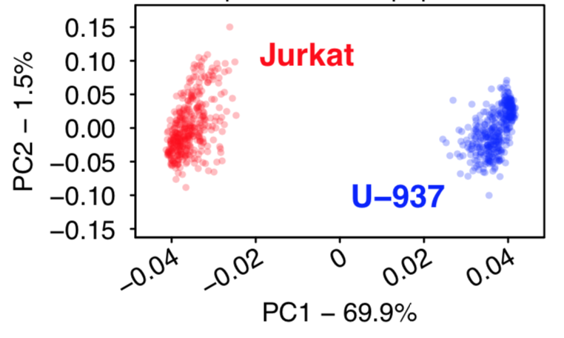
Goal of single cell proteomics?
Notes:
Whats the goal of single cell proteomics?
PCA separation of two cell types – you’ll commonly see this in a lot of publications
Is it useful? We can achieve it with just one protein
We want to interrogate pathways, we want to capture a representative picture of the cell state
To do this, we need to analyze a large and diverse set of proteins – a difficult problem especially for single cell proteomics

Slide 3
How to sequence a peptide ion?
Mass Spectrometer
MS1
Inlet
mass/charge (m/z)
“Mass”
Mass Analyzer
Notes:
How do we measure proteins with a mass spectrometer? One strategy – break down proteins into peptides and relate peptide measurements to protein measurements later
The instrument only sees ions – need to assign peptide sequences in order to connect to actual biology
When ions enter the instrument we can measure their m/zs (mass/charge ratio) with very high accuracy – down to the mass of an electron.
But this information is not sufficient to assign an amino acid sequence to the ion
This graph represents the instrument seeing many ions, which are represented here as peaks (corresponding to intensity) along the m/z axis.
So just by looking at one of these peaks, although we have its m/z – its x-value – measured extremely accurately, we cannot, without more information, directly determine its peptide sequence.

Slide 4
How to sequence a peptide ion?
MS1
Mass Spectrometer
Collision Cell
MS2
Mass Filter
Inlet
Mass Analyzer
mass/charge (m/z)
“Mass”
Notes:
What we do is look at the initial scan (MS1 spectra), and isolate an individual ion.
We then blow it up into bits, and then measure the m/zs of the resulting fragments. This is called an MS2 spectra
This MAY be enough information to identify the peptide sequence of this ion.

Slide 5
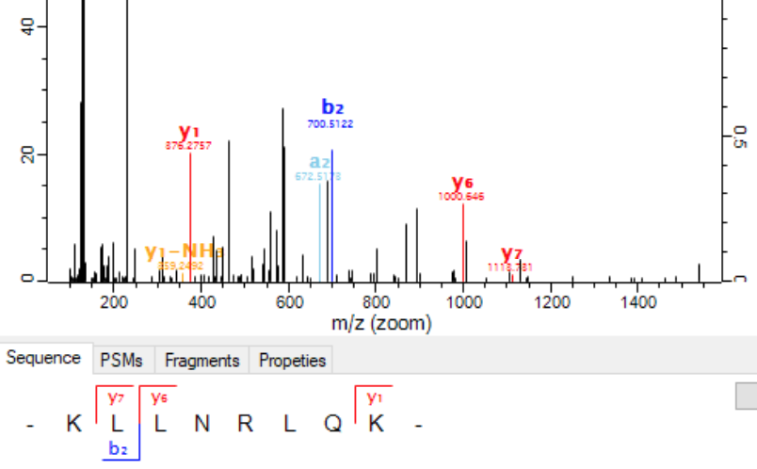
De-novo sequencing
De-novo may be challenging...
Notes:
Sometimes we get so many unique fragments that we can identify the sequence without making any prior assumptions – this is called “de-novo” sequencing.
Here’s an example. We observe a dipeptide b2, and a tripeptide b3. The mass difference between b2 and b3 is exactly the mass of the amino acid glutamine (Q). We can go on and on like that until we have the complete sequence.
However (pause), MS2 spectra like these are the exception. We mostly only observe a few fragments. Imagine if we only get a small fraction of these fragments (show bad spectra). There’s not enough “components” to do this reliably.
De-novo is great, its very empirical (we make no prior assumptions about what we think the ion is), but its challenging and remains an open field.

Slide 6
Hypothesis Testing
VTVPLVR
...
...
AQSEAEK
Notes:
Instead, the most widely used method is called hypothesis testing. We assume a finite set of spectra – in our case we assume that peptides are from the human proteome since we know we injected a human cell.
From the human genome we can in silico translate to amino acid sequences and derive theoretical fragments – theoretical MS2 spectra.
With simple cross-correlation, we can identify confident hits from observed MS2 spectra to theoretical MS2 spectra.
This method is still challenging. We can account for post-translational modifications, like phosphorylation, but this results in even more hypotheses to test.
The observed spectra can also have very few fragments, or those fragments can be very close to the noise level (as is frequently the case in our SCOPE-MS samples)

Slide 7
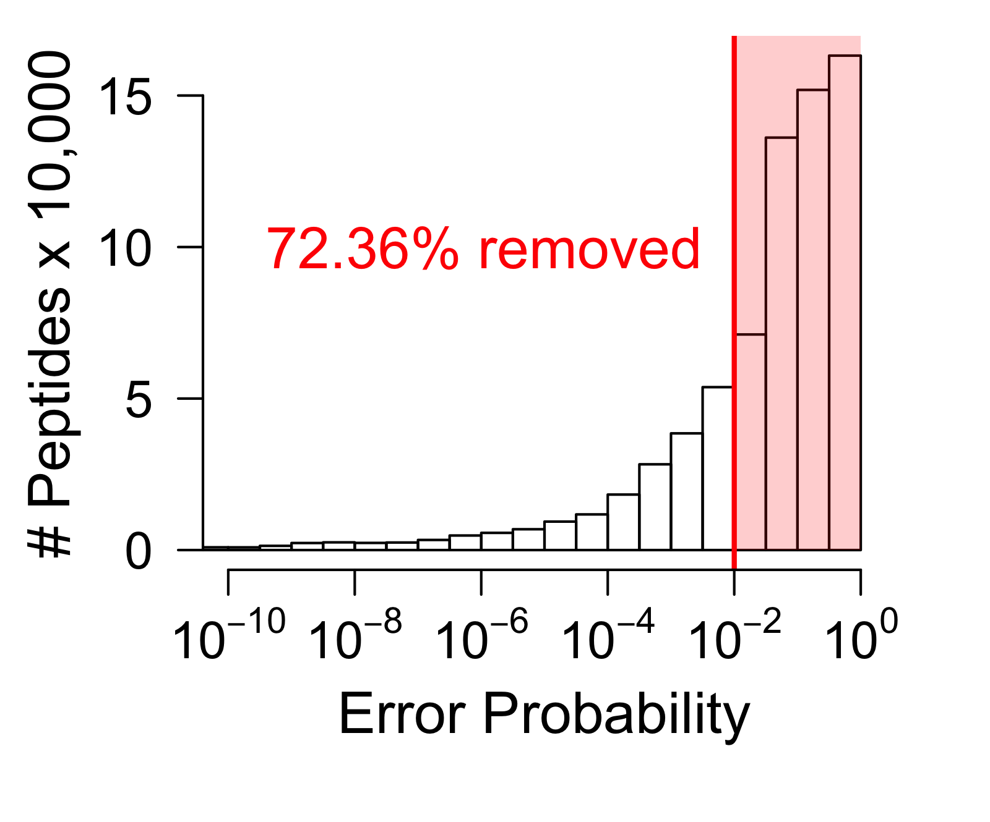
Consequences
Peptide Spectrum Matches (PSMs)
Notes:
Consequently, most of our PSMs (our hypotheses) are of too low confidence to be used further for biological inferences and analyses. Normally, most people throw these observations in the trash can, before doing true biological analysis of their data.
But are these observations really trash? Just because we can’t get a confident ID, doesn’t mean there isn’t useful information there. For isobaric tags/TMT especially, there is useful quantification data in the MS2 spectra.
Not actually trash, but we’re just treating it like trash – consequence of low confidence when comparing spectra
So what do we do about this? Can we come up with some computational way to increase the confidence in these low-quality matches?

Slide 8
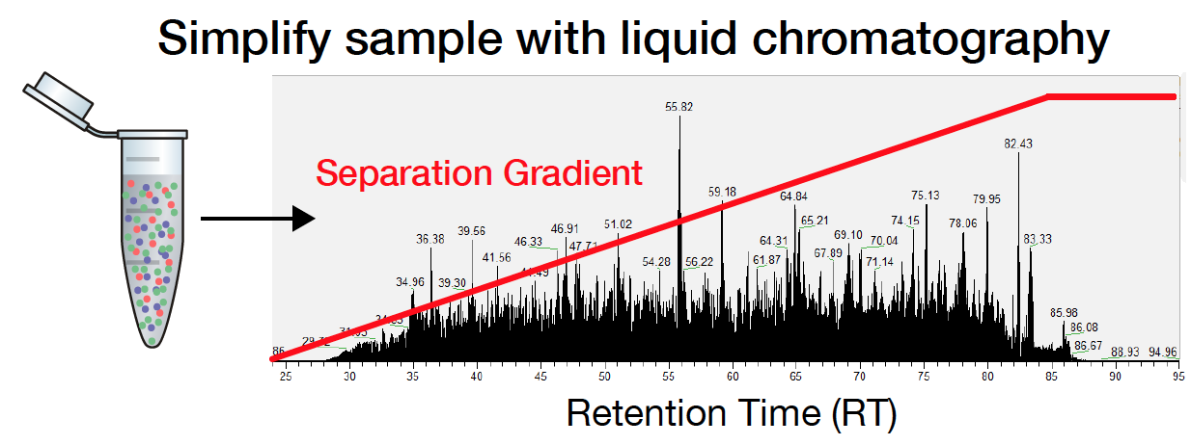
Incorporate more features
MS2
+ Retention time (RT)
+ MS1
m/z
Sample
Retention time (min)
Notes:
So far, to identify a peptide from an ion, we use the m/z of the intact peptide, and the MS2 spectra – the fragments we get after blowing up the peptide.
But these aren’t the only features that we can use to help identify peptides
We use liquid chromatography coupled to mass spectrometry (LC-MS/MS).
Separation is determined by the physical properties of the peptide, such as the peptide sequence and the position of each amino acid. We can therefore draw a strong connection between the retention time and the peptide sequence – this is a concept that we will explore shortly.

Slide 9
Existing Approaches
Incorporating retention time into identification
Notes:
This solution – incorporating retention time into identification – is a crucial part of our new method, DART-ID, but like I just mentioned it has also been implemented in various forms over the last 20 years. What I will show is by no means an exhaustive list of methods or approaches, but I really want to differentiate our method from these existing ones, and motivate why we decided to do what we did.

Slide 10
Feature-matching
Future Experiments:
+
Assume accurate mass and retention time
MaxQuant match-between-runs (MBR)
Isobaric MBR
moFF MBR
DeMix-Q
Open-MS FFId
m/z
VSANPETK
+
+
m/z
Retention time
Retention Time
Notes:
(don’t have to say this)... So I explained before that the m/z of an ion is not enough to sequence a peptide. This is mainly because the m/z is not unique in complex samples such as the proteome of a human cell. If we have a simpler sample (maybe say, exosomes or brain fluid), then uniqueness of the m/z-RT coordinate is more likely.
Assuming we can measure our m/zs and retention times accurately AND consistently – which is very difficult in practice, then we can map a sequence to its m/z-RT coordinates.
In future experiments, as long as we see an ion here in this oval, we can assume it’s the same peptide sequence that we sequenced before – we don’t even need to fragment it again.
Measuring m/z and especially RT accurately is very hard practically. Methods like match-between-runs in MaxQuant’s MBR can computationally correct for experimental variation to help with this strategy.
But how can we control for measurement error?
What if we observe it right on the edge?
How large should this oval be?
Control for a large density of ions?
What if we observe two in the oval? Or more?
For MS1-based quantification, like LFQ/SILAC, these methods are great. They can pull quantitative data out of peptides without requiring that they be fragmented in a separate scan.
However, these methods only look at MS1-level characteristics like m/z and RT – for these future experiments they don’t factor in a fragment spectra if it was collected. → leaving data on the table

Slide 11
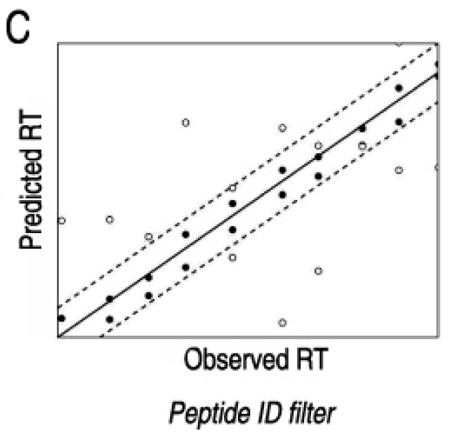
MS2-based classifiers
VSANPETK
30.5 minutes
Klammer et al.l (2007)
Pfeifer et al (2009)
Strittmatter et al. (2004)
Li et al (2009)
CharmeRT/Elutator
Percolator
Notes:
The second group of methods that incorporate RT are what I’m going to call classifiers.
The simplest version of this is a filter based on the agreement of observed retention time and predicted retention time. This assumes that all observations that fall outside of the bounds are false positives to be discarded
Rely on being able to predict this retention time for a peptide given its sequence – a problem I will describe later. For now assume that we can predict this reasonably accurately
The simplest version of this is a filter based on the agreement of observed retention time and predicted retention time. This assumes that all observations that fall outside of the bounds are false positives to be discarded

Slide 12
Desired Method:
Incorporate MS2 Spectra
Probability-based
Minimize assumptions and heuristics
Easily generalizable to more evidence
Notes:
Desired method:
- The first group of methods only used the information about the precursor (m/z, RT, intensity) but don't take into account the spectrum. The spectrum might not be enough information alone to determine the experiment, but its still useful. For TMT especially, we NEED this MS2 spectra
We want to avoid arbitrary thresholds. Instead of infinitely incorrect/correct, want a nuanced confidence estimate. Keep ourselves in probability-land to avoid tuning heuristic functions
Want it to be generalizable to other pieces of evidence (drift times – shout-out to Bruker timsTOF)

Slide 13


Use Bayes’ Theorem!
Retention time evidence
Updated confidence
Spectral confidence
$$P\left(\text{ID} | \text{RT}\right)=P\left(\text{ID}\right)∗\frac{P\left(\text{RT} | \text{ID}\right)}{P(\text{RT})}$$
$$P\left(\text{ID} \text{correct} | \text{RT}\right)= \frac{P\left(\text{RT} | \text{ID} \text{correct}\right)∗P(\text{ID} \text{correct})}{P(\text{RT})}$$
Notes:
So the method that fits all of this criteria is surprisingly simple - its using Bayes' Theorem. It's essentially a rigorous way to incorporate additional evidence to a hypothesis based on a likelihood function.
Use prior probability P(ID) and likelihood function (...)
Bayes’ Theorem gives us an extremely straightfowards framework to incorporate additional evidence into our existing evidence (the strength of the spectra to that of the theoretical peptide).

Slide 14



Easily Generalizable
Retention time
Drift time
MS1 Intensity
$$P\left(ID | RT,A,B\right)=P\left(ID\right)∗\frac{P\left(RT | ID\right)}{P(RT)}$$
$$∗\frac{P\left(A | ID\right)}{P(A)}$$
$$∗\frac{P\left(B | ID\right)}{P(B)}$$
Notes:
And this framework is very easily generalizable to additional pieces of evidence. Just by adding terms we can incorporate information from drift cells (FAIMS), and MS1 intensity that match-between-runs methods have managed to incorporate.
In DART-ID we only use RT, but here I’m just noting that extending our method using Bayes’ Theorem with more features is very simple.

Slide 15
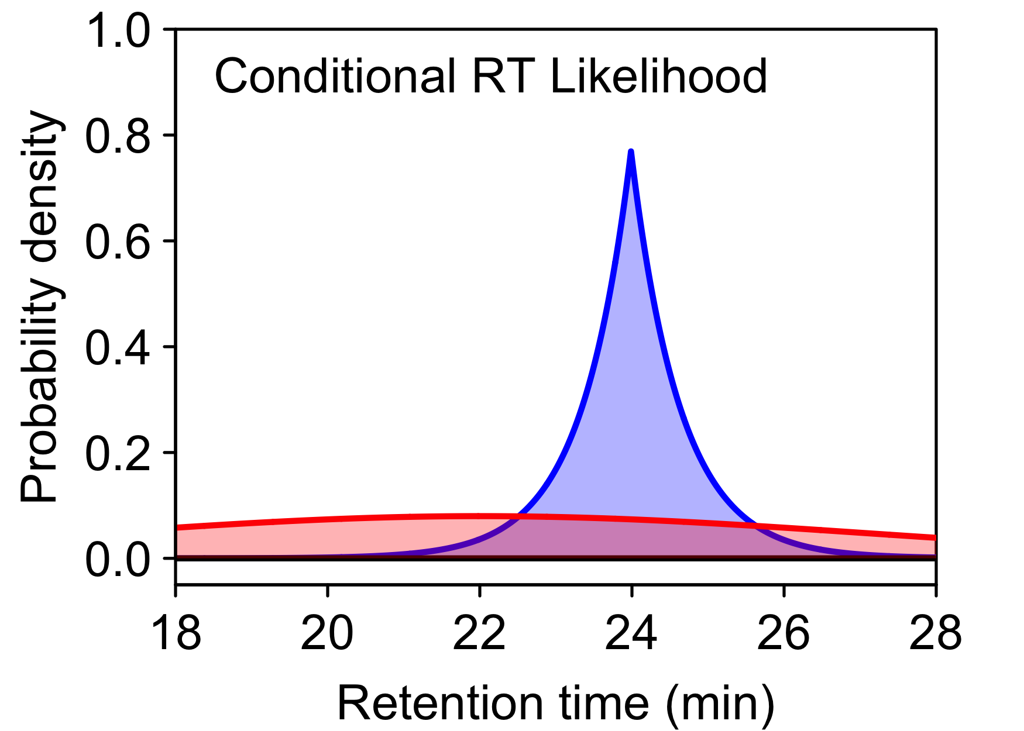
Retention time as a feature
VSANPETK
Upgrade Confidence
Correct
Incorrect
x
x
Downgrade Confidence
Notes:
Here is a graphical explanation of what we’re doing with Bayes’ Theorem. If we can get an accurate prediction of retention times (which is something I’ll go into in just a second), then we can use that information to better classify our identifications as true or false positives.
Blue = probability of RT given that the peptide sequence assignment is correct
Red = probability of RT given that the peptide sequence assignment is incorrect – i.e., that it belongs to any other sequence
PSM1, PSM2 examples...
This very intuitive framework is exactly what is being rigorously expressed in DART-ID
What is clear from that picture is that we need to have accurate estimates for the RT. Why? Because the more accurate, we more informative the likelihood is. i.e., the more different the correct distribution is from the null distribution. Red/blue distributions are much more similar on the top than on the bottom. We want as accurate estimates as possible.

Slide 16
DART-ID: Global RT Alignment
Notes:
So one part of our method DART-ID is to use Bayes’ Theorem as the base for incorporating the retention time evidence. I just showed that the this method shows the potential to improve proportional to how accurate we can infer peptide retention times. This second part of the method is how we were able to reduce our alignment error down from 15 seconds in conventional methods to about 3 seconds with DART-ID.

Slide 17
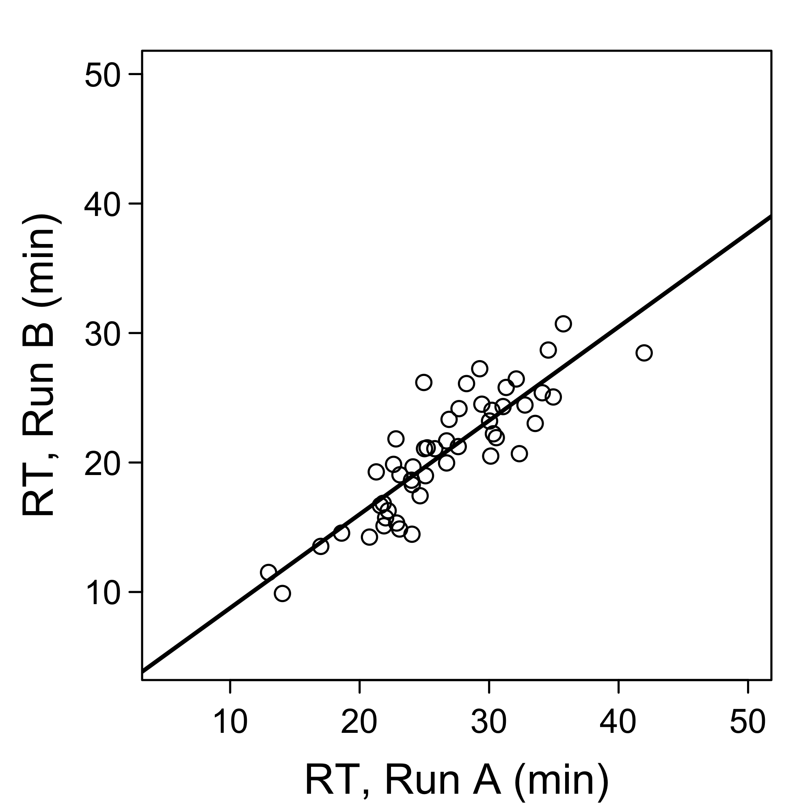
Retention time alignment
VSANPETK
o
Notes:
So far the most accurate way to predict peptide RTs is through RT alignments.
The basic intuition is that we can relate the retention times of two experiments with a function.
We can then predict the retention time of this peptide in Run B by mapping its measured retention time in Run A onto this functional relationship.
In this case the functional relationship is just a single slope linear model – but over the past 2 decades there has been a lot of added complexity

Slide 18
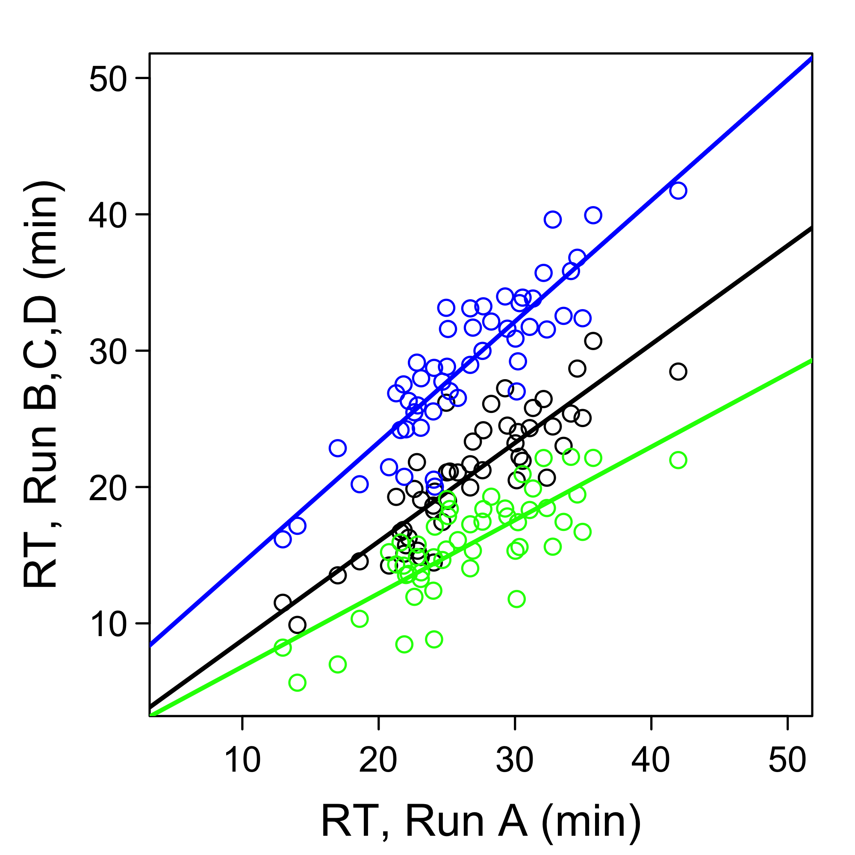
Out of 100, which one?
B
C
D
Notes:
Here’s the alignment extended to 4 experiments – Our reference, A, and three others, B,C,D.
But what if we choose B as the reference? Or C? Our alignments and subsequent retention time predictions will change.

Slide 19
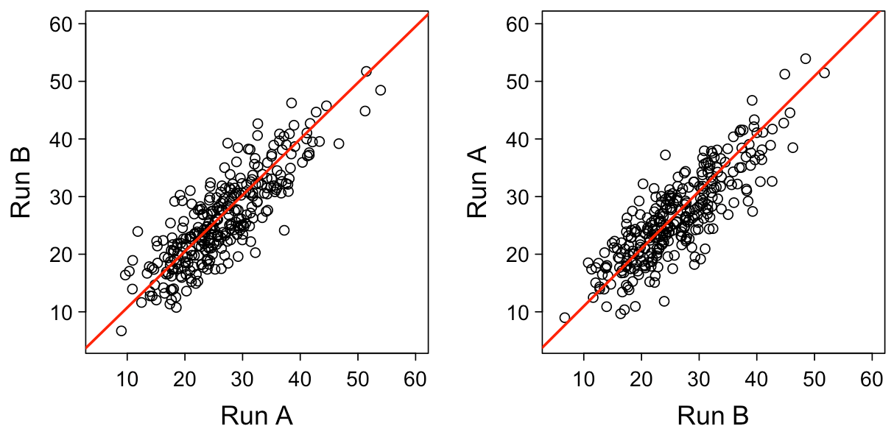
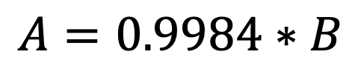
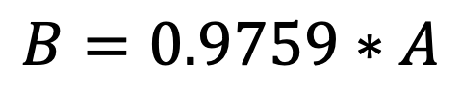
Partial least squares
$$B=0.9759∗A$$
$$A=0.9984∗B$$
Notes:
Say we have 100 experiments – we have to choose one experiment to align against – to “anchor to”
Which one do we choose? The choice will have a quantitative difference on our alignment and predicted RTs.
This is a consequence of partial least squares. If you ignore errors in the independent variable you will underestimate the slope.
(only say to answer a question) The solution to this problem is to use total-least-squares instead of partial. One potential method to do this that we haven’t explored in depth is PCA/SVD to solve total least squares. We instead opted for a model-based generalization of this...

Slide 20
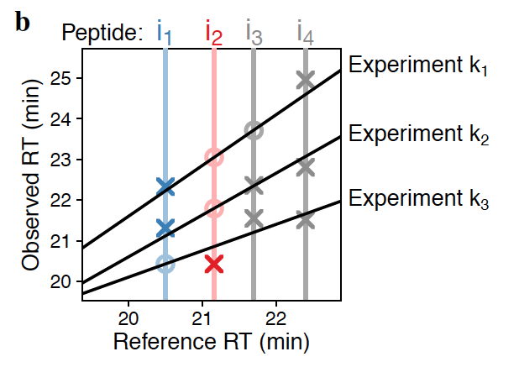
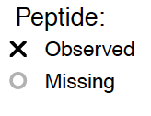
Global Alignment Model
Notes:
Came up with a model where the reference RT is a latent variable (a variable whose value we don't know to begin with). With that latent variable we can make a model to the observed RTs and fit this model with ONE global fit to infer the latent reference RTs.
Bonus: very robust to missing data

Slide 21
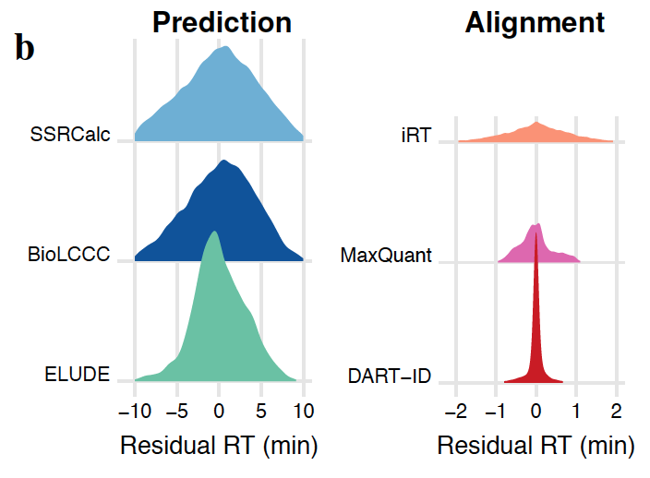
For 60 min LC-MS/MS run,
Median error of 3 seconds!
Notes:
Does it work? We wanted to compare the error of applying this procedure to hundreds of LC-MS/MS runs. These are runs of SCOPE standards on 60 min gradients.
We compared it against iRT and MaxQuant’s alignment used for match-between-runs -- both good alignment methods for what their methods aim to do.
All methods achieve fairly good alignment. Looking more closely, what are the errors, between the observed and aligned RTs? Even the very best methods, MQ and iRT, tend to have higher errors as compared to DART-ID. Median residual error for DART is only 3 seconds.

Slide 22
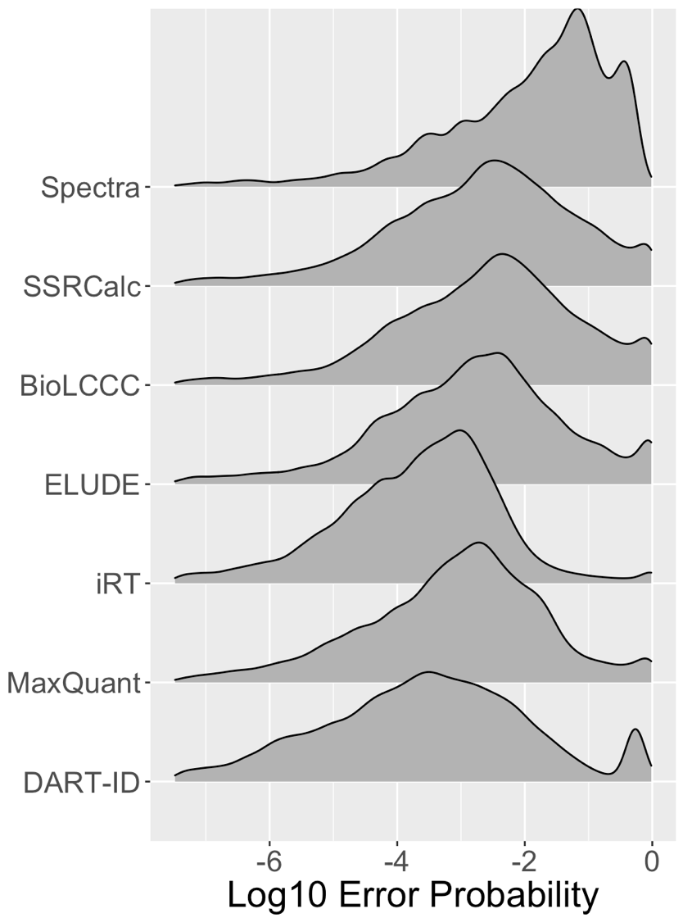
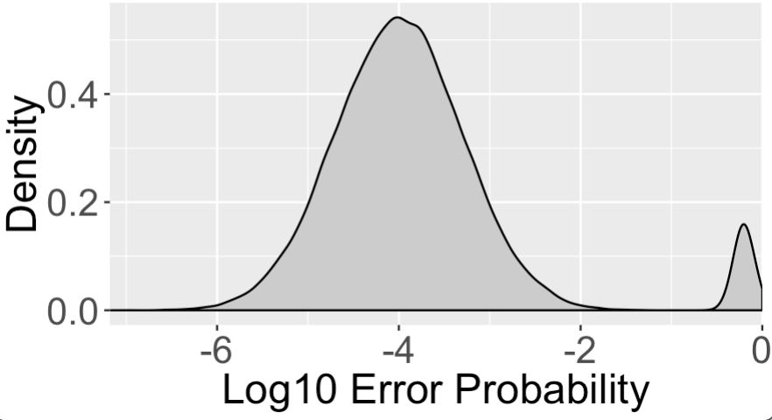

Ideal scenario:
Classification power $∝\text{RT} \text{accuracy}$
More accurate retention time inferences give greater classification power
Notes:
Why does it matter to have accurate RTs? I already mentioned that the information in the peptide is proportional to this accuracy. One benefit is to see how much this added accuracy benefits the classification. Remember that the classification is binary: correct/incorrect. Ideally we have a fully bimodal distribution - either its correct or incorrect (either have very low or very high confidences)
(show left figure)
On the top, we have the distribution of error probabilities from Spectra alone, as given to us by the MaxQuant search engine. – theres a lot of uncertainty
The rest of the rows are RT prediction methods, sorted descending by prediction accuracy, with DART at the bottom.
Here the updated confidence estimates use the RT estimates from the respective method, plugged into our Bayes’ Theorem method, which is run on top of the error probabilities in the Spectra distribution.
The distribution from DART is the most bimodal one. It has the most statistical power to increase the confidence in the correct PSMs while downgrading the incorrect ones.
Classification power (proportional sign) RT accuracy

Slide 23
DART-ID Increases Proteome Coverage
Notes:
So how does it look when we apply DART on our SCOPE data?

Slide 24
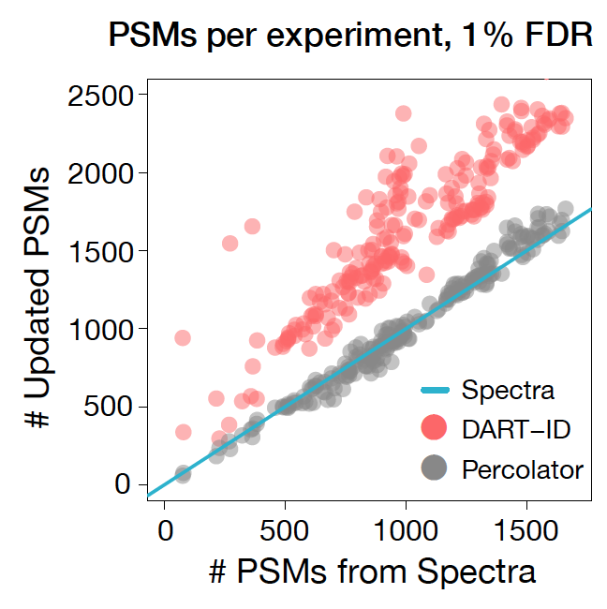
~50% more peptide identifications
Notes:
First off, we are able to get about 50% more PSMs at 1% FDR – these are identifications that would have been tossed in the garbage prior to using DART-ID.
Here is one example of the number of confident PSMs that we can derive from spectra alone (from MQ, which we know and love). Describe axes and colors... And we see that Percolator results in about the same number of confident IDs as MQ alone. DART generally increases the # of confident PSMs

Slide 25
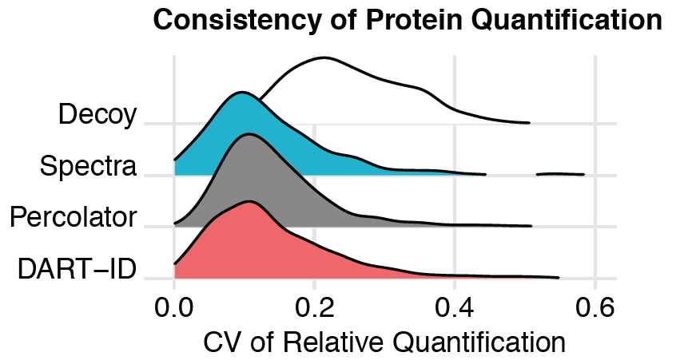

Boosted PSMs give consistent quantification
Protein A
Peptide 1
Peptide 2
Fold-Change
...
Peptide N
0
$$\text{CV}= \frac{σ}{μ}= \frac{\text{Standard} \text{deviation}}{\text{Mean}}$$
Notes:
And now we can ask: are they quantitative? But do they contain information that is useful for the analysis of proteins?
One way to approach this question is to ask if relative protein levels, estimated from those IDs that DART identifies, are they consistent with quantification derived from PSMs with high quality spectra?
One measure of this consistency is CV - describe CV
Ideally all peptide fold-changes are the same. CV of 0 means all peptides agree with each other – 0 noise scenario
Large CVs, or CVs of infinity, means that there’s a lot of noise taking the measurements, or that the peptide assignments are incorrect. The fold-change is from a different peptide IRL.
Data indicate that the CV for DART is just as small than that of Spectra alone. That means that quant derived from DART is just as reliable as from that derived from spectra alone.
Describe decoy database – we have no expectation that random peptides from random proteins will have the same fold-change.

Slide 26
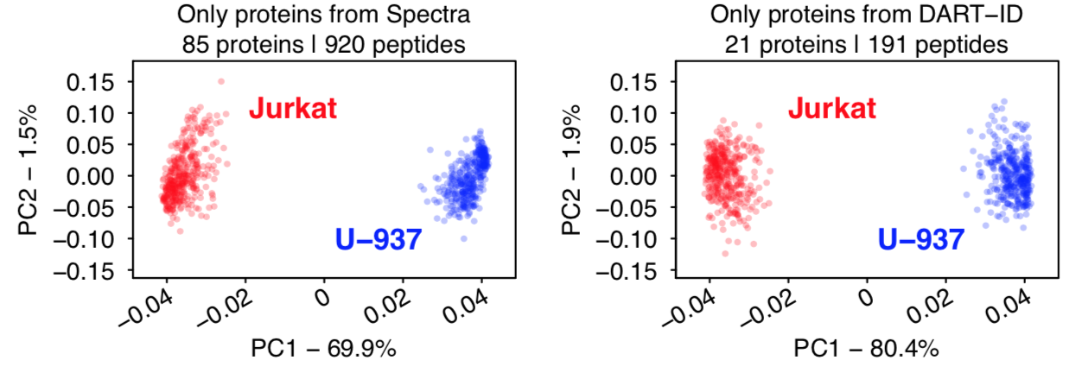
Boosted PSMs separate proteomes
Spectra
DART-ID
Notes:
Not only can we use that benchmark. We can take ONLY the boosted PSMs - PSMs that we would have thrown away, and we can use it to correctly identify the cell type used in our analyses.
Here is PCA, where top is with only confident PSMs and bottom is with only DART PSMs – a subset of data that we pulled out of the trash bin, because these observations had consistent retention times.

Slide 27
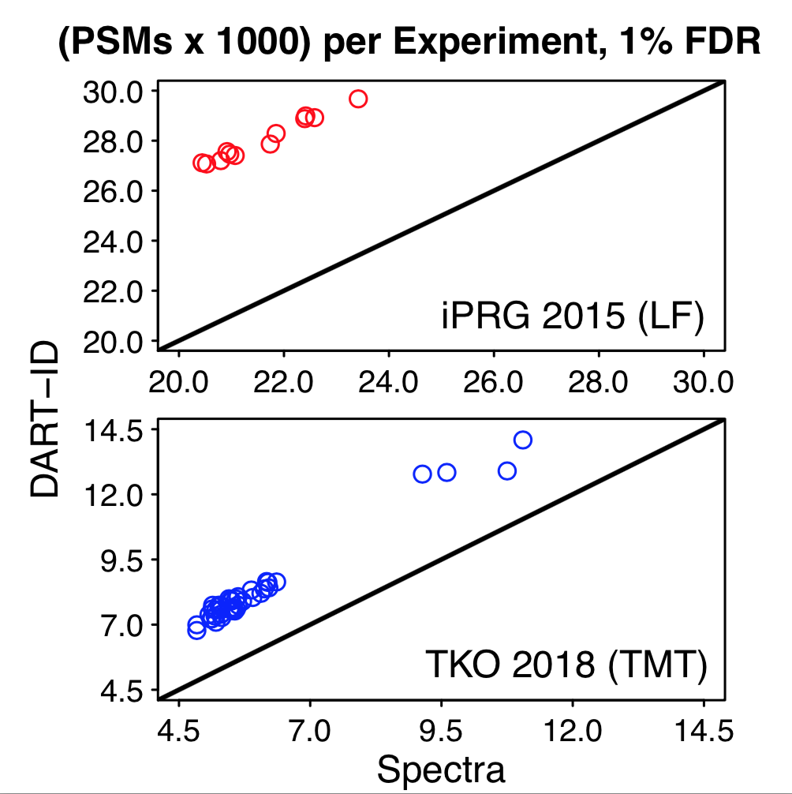
DART-ID in bulk sets
Notes:
On average, when we apply DART to SCOPE (and also with bulk sets) we can increase proteome coverage by 50%.
It can be applied to pre-existing data...
EXPLAIN THE AXES
Mention that reviewers had us do this. Thanks reviewers!

Slide 28
DART-ID increases proteome coverage by up to 50%
Apply computationally to existing data
Notes:
... So what is DART-ID? For experiments with MS2-based quantification (TMT), we can increase quantitative proteome coverage by up to 50%.
And this is purely a computational method – if you have consistent liquid chromatography, you can add this on without re-running data or making any experimental considerations.

Slide 29
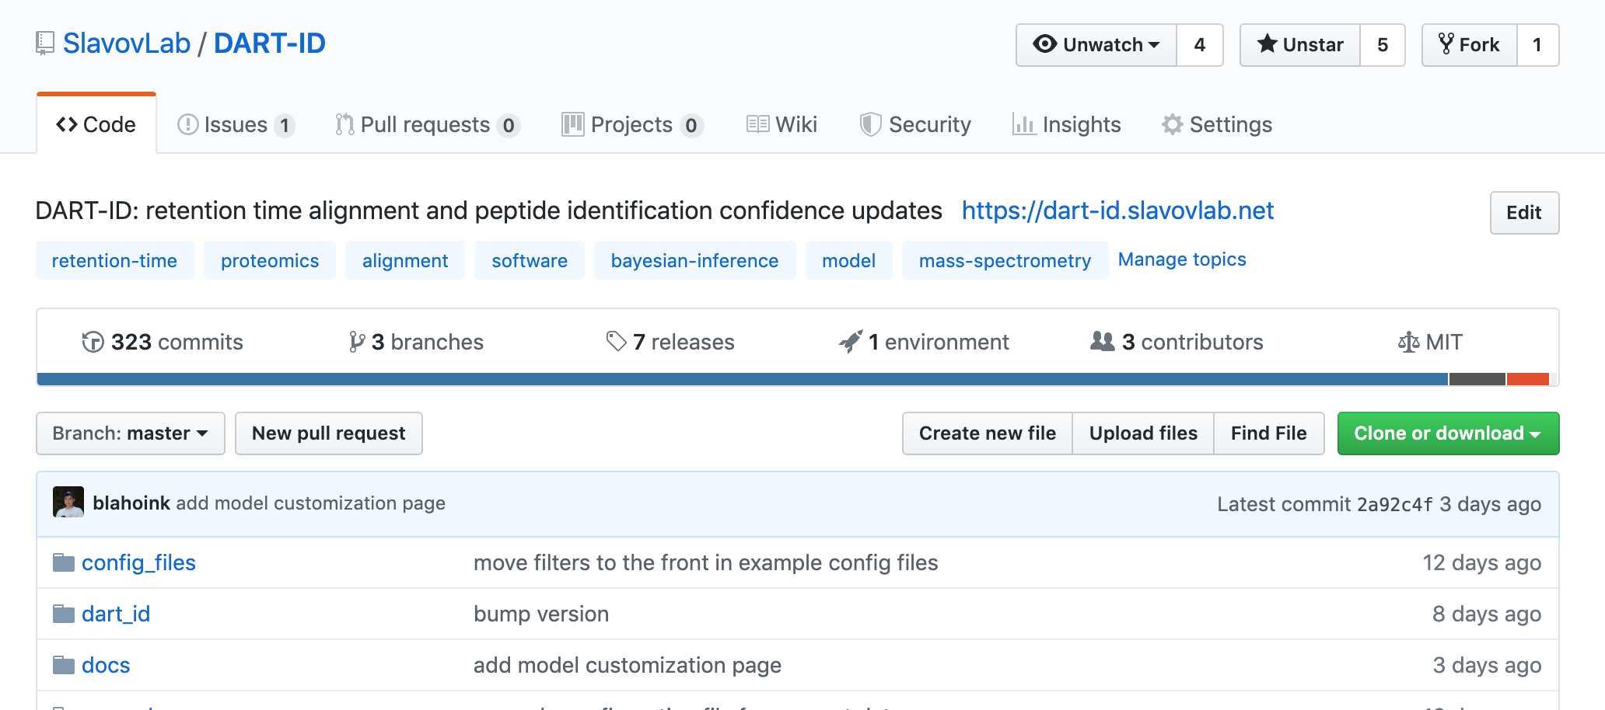
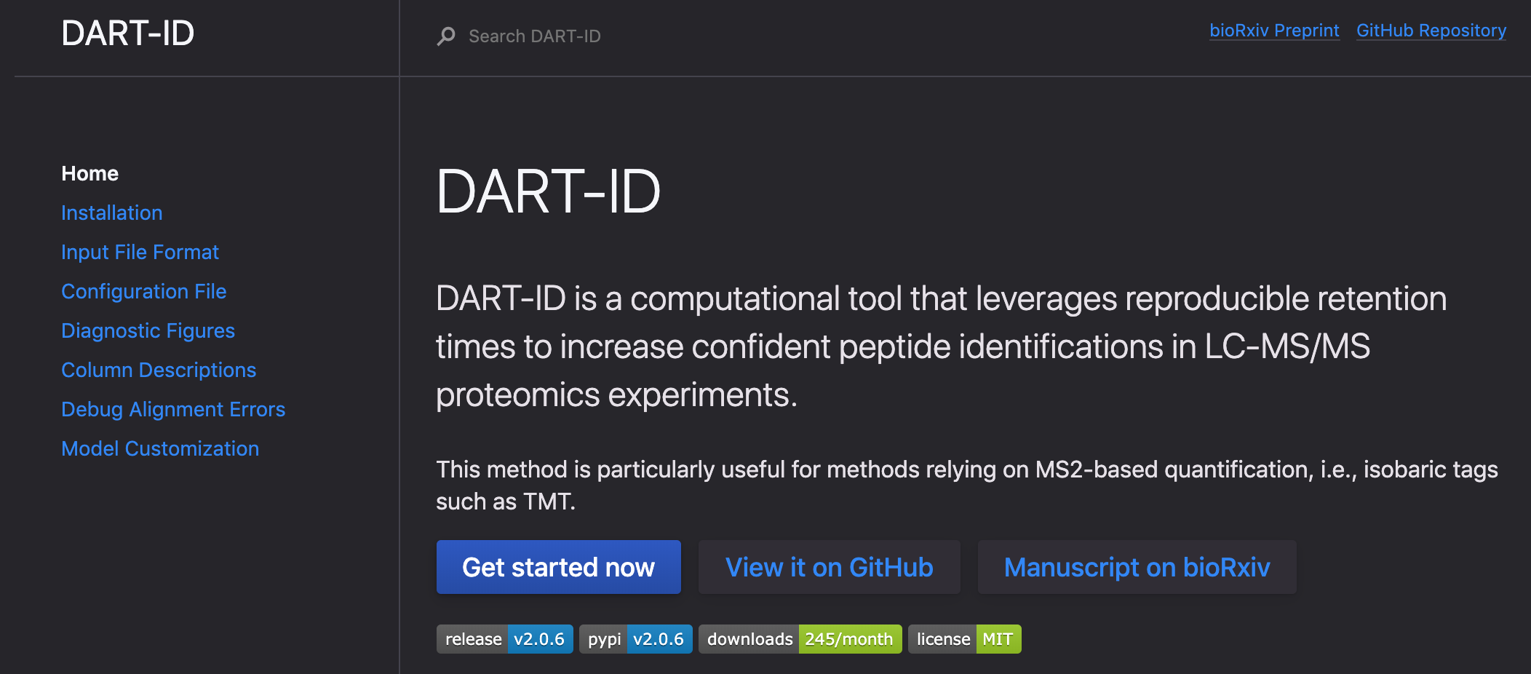
Freely available online
https://dart-id.slavovlab.net

Slide 30
Extensions
Extend Bayes’ Theorem to:
Ion drift time (Bruker timsTOF)
MS1 Intensity
Community:
Reduce reliance on MS2 spectra. Use more features, use all the data!
Notes:
Here’s a non-exhaustive list of some potential improvements that we could add onto this project
Bayes’ theorem is extendable – can easily tack on drift time and MS1 intensity as features
Community has opportunities to take this further or in different directions. We can improve search engines, and we can work on incorporating all the different forms of data that the MS spits out.
And the general direction for the community and the general spirit in which we have developed this method is to use fully the features in the data, to leave nothing on the table.

Slide 31
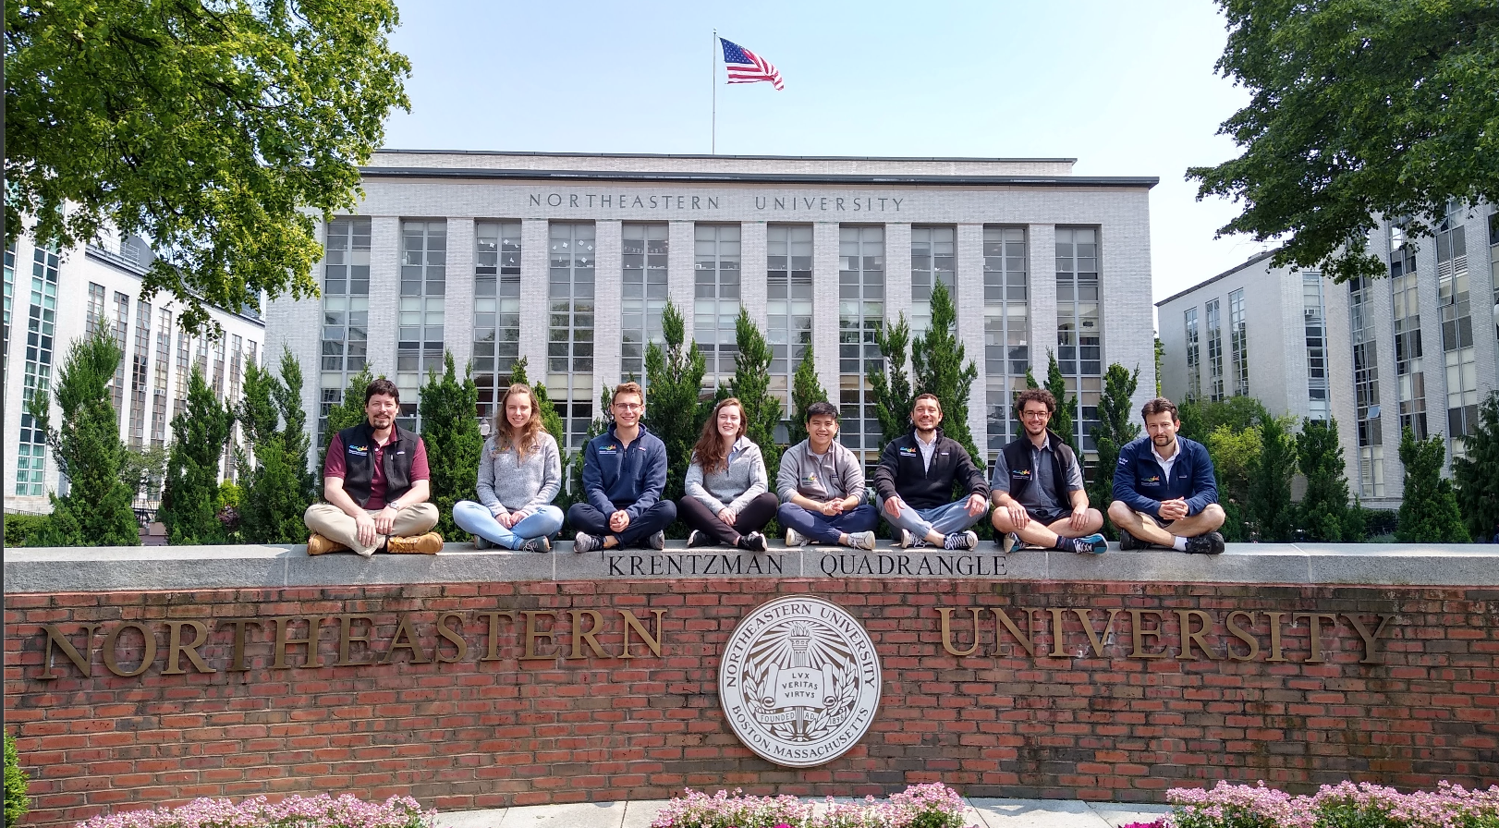



Thanks to:
The Slavov Lab
Nikolai Slavov
Aleksandra Petelski
Annie Schide
David H. Perlman
Edward Emmott
Ezra Levy
Gray Huffman
Harrison Specht
Toni Koller
UC Santa Barbara
Alexander Franks

Slide 32

Feedback
LINK:
http://bit.ly/SCP2019_DART
Questions welcome, and thanks for listening!
Notes:
I'm looking to improve my presentations
...

Slide 33
APPENDIX

Slide 34
How to sequence a peptide ion?

Slide 35
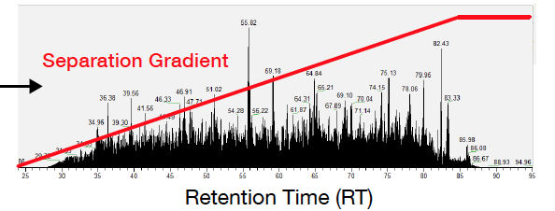
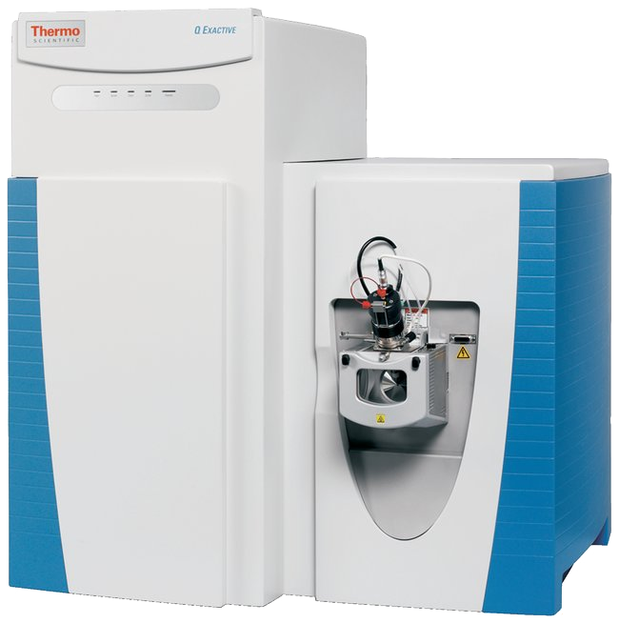
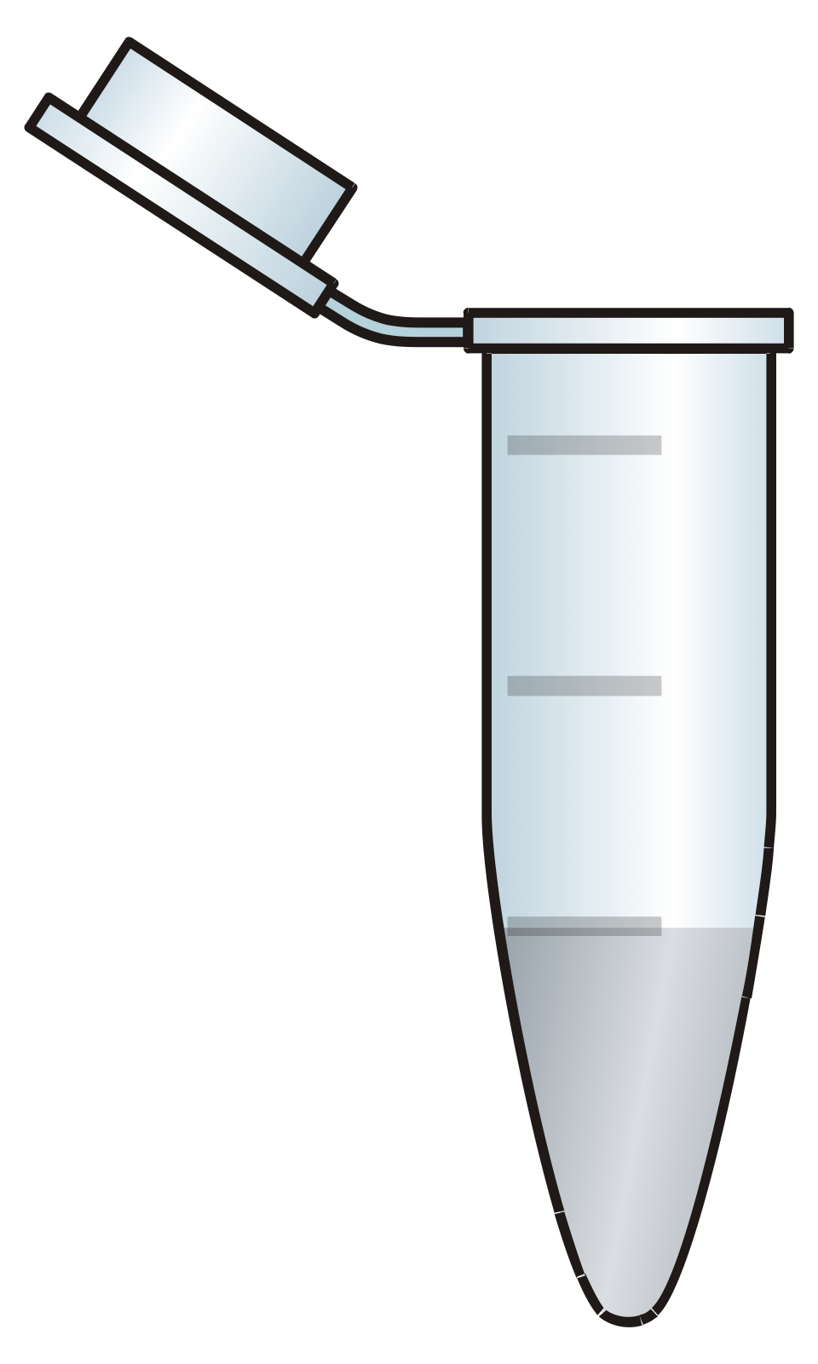
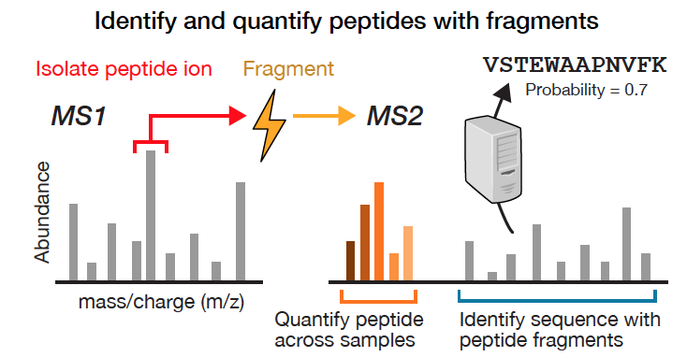
Lightning Review
Ionization
Analytical Column
Ions
Sample
Mass Spectrometer

Slide 36
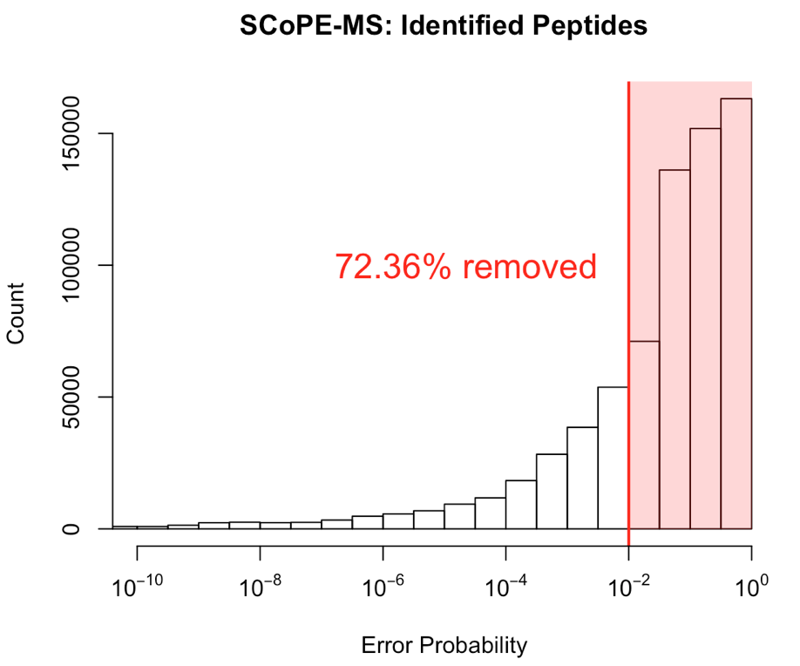
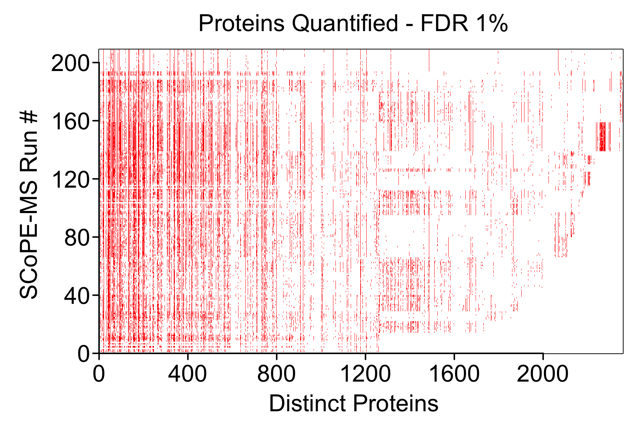
Consequences
Red = identified & quantified
Notes:
Ok, so either we miss identifications altogether or we’re forced to throw out our low-confidence IDs because we tested too many hypotheses. The histogram I’m showing to the left is from our single-cell mass spec data (SCOPE-MS), where a significant chunk of our IDs have to be tossed.
The consequence of this is not just the number of proteins we can analyze but also the completeness of our quantitation. On the right I’m showing proteins on the x-axis, and LC-MS/MS runs on the y-axis, and marking a quantitation event with red. As you can see our measurement processes are very stochastic. If we want to do an analysis like PCA, we will have to impute some of these gaps, and for very sparse proteins we may have to toss those as well.

Slide 37
MS2-based classifiers
Support Vector Machine
Klammer et al (2007)
Pfeifer et al (2009)
Strittmatter et al (2004)
Li et al (2009)
CharmeRT/Elutator
Percolator
Notes:
Most widely used is Percolator - an SVM that uses kernels to model the relationship between observed and library RT of a peptide. These kernels are sophisticated but have to assume a functional relationship, which you don't know to begin with. You don’t know the functional form of RT -> correctness. Which non-linear kernel to choose?

Slide 38
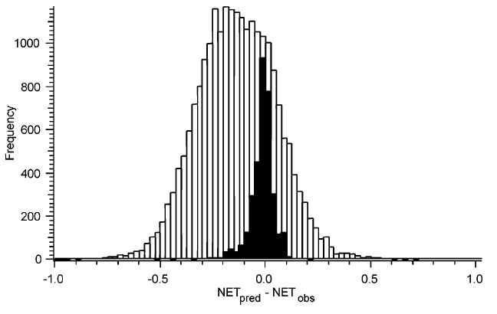
MS2-based classifiers
False Positives
True Positives
Klammer et al (2007)
Pfeifer et al (2009)
Strittmatter et al (2004)
Li et al (2009)
CharmeRT/Elutator
Retention time error
Strittmatter et al (2004)
Notes:
A more nuanced approach is to treat the retention time error – i.e., the difference between the observed and predicted retention times – as a classifier between our true and false positives that can be incorporated into a larger function that aims to separate these true and false positives with a threshold.

Slide 39
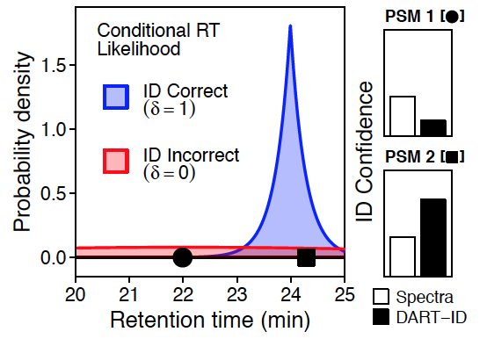
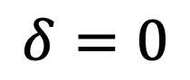
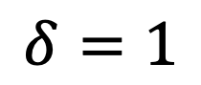
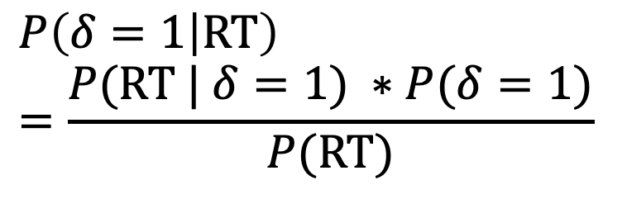
Retention time as a feature
$$P\left(δ=1 | \text{RT}\right)=\frac{P(\text{RT} | δ=1) ∗P(δ=1)}{P(\text{RT})}$$
$$δ=1$$
Assigned sequence is correct
$$δ=0$$
Assigned sequence is incorrect
Notes:
Here is a graphical explanation of what we’re doing with Bayes’ Theorem. If we can get an accurate prediction of retention times (which is something I’ll go into in just a second), then we can use that information to better classify our identifications as true or false positives.
Blue = probability of RT given that the peptide sequence assignment is correct
Red = probability of RT given that the peptide sequence assignment is incorrect – i.e., that it belongs to any other sequence
PSM1, PSM2 examples...
Key to the classification ability of this method is the difference in the blue and red distributions. Note that if they were the same, we would no boost in confidence. In this case above, we have a window of about 2 minutes where if the RT falls within that window we can upgrade its confidence. The bigger the ratio between the density of the blue to the red distribution, the more we can boost.

Slide 40
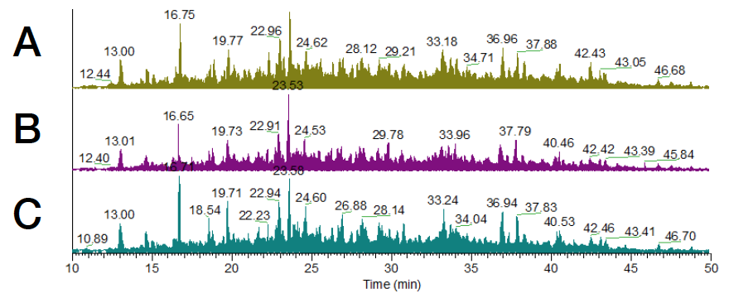
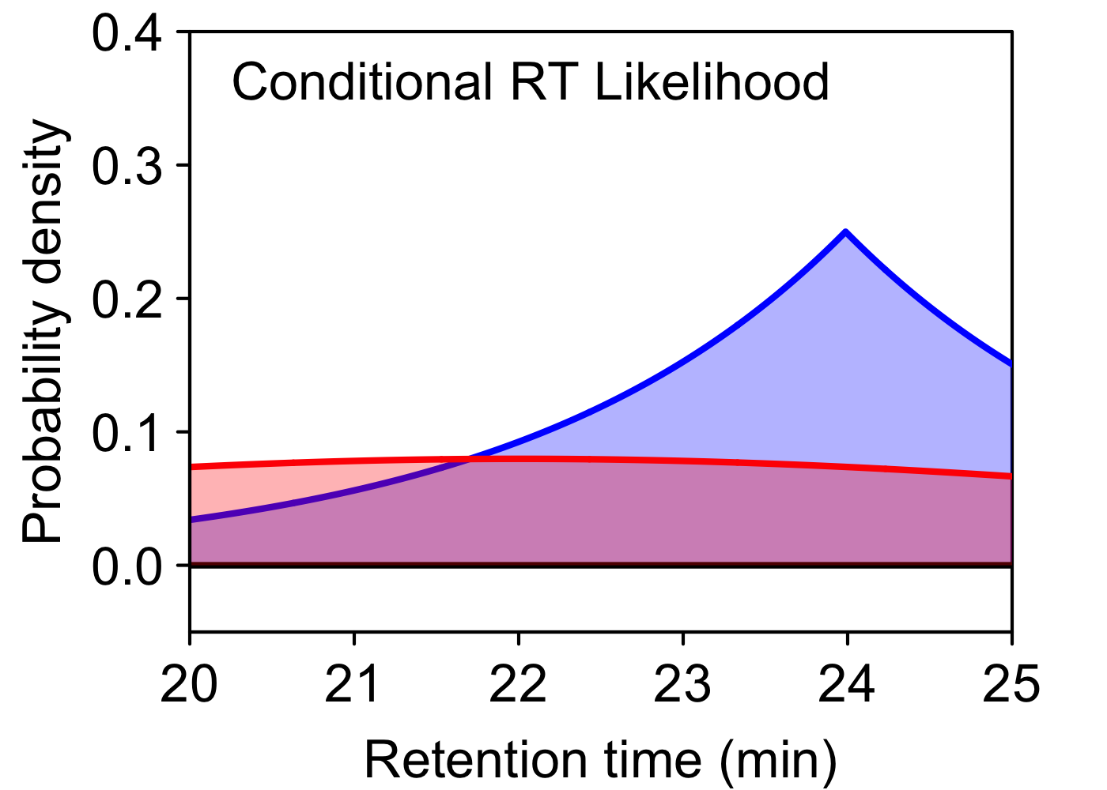
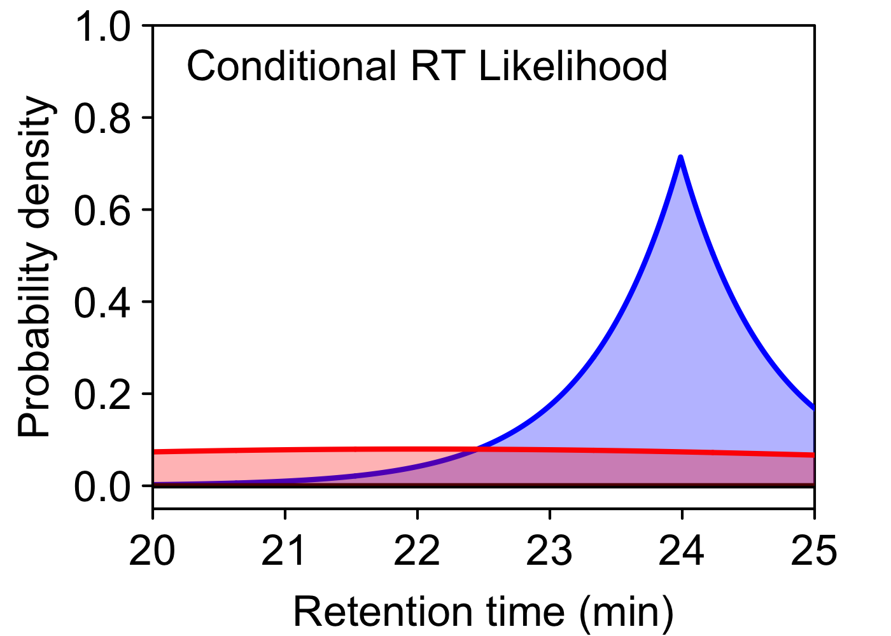
RT Prediction
RT Alignments
VSANPETK
24.2
Error ~ 2 – 3 minutes (60 min run)
Error ~ 15 – 30 seconds (60 min run)
ID Correct
ID Incorrect
ID Correct
ID Incorrect
Notes:
One way to make inferences about the retention time of a peptide is with a linear combination of the hydrophobicity of each amino acid. This is fast, easy, and requires no prior data, but these methods are less accurate.
As a result, we get less statistical power when using Bayes’ Theorem
We can more accurate estimates of retention times by relating the rank order of elution to each experiment, through alignment methods. These result in much lower errors, and thus more statistical power when we use Bayes’ Theorem.
Applying Bayes’ to existing methods of retention time prediction is great – it already gives us great performance separating our true and false positive peptide matches. But this motivated us to go further. If we could reduce this error even more, then we could squeeze out even greater gains from Bayes’ Theorem.

Slide 41
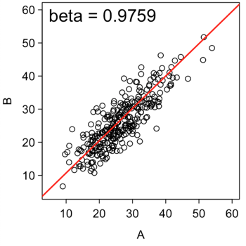
RT Prediction
g_{k}( VSANPETK )
24.2
VSANPETK
ID Correct
24.2 min
ID Incorrect
Error ~ 2 – 3 minutes (60 min run)
RT Alignments
ID Correct
ID Incorrect
Error ~ 15 – 30 seconds (60 min run)
Notes:
One way to make inferences about the retention time of a peptide is with a linear combination of the hydrophobicity of each amino acid. This is fast, easy, and requires no prior data, but these methods are less accurate.
As a result, we get less statistical power when using Bayes’ Theorem
We can more accurate estimates of retention times by relating the rank order of elution to each experiment, through alignment methods. These result in much lower errors, and thus more statistical power when we use Bayes’ Theorem.
Applying Bayes’ to existing methods of retention time prediction is great – it already gives us great performance separating our true and false positive peptide matches. But this motivated us to go further. If we could reduce this error even more, then we could squeeze out even greater gains from Bayes’ Theorem.

Slide 42
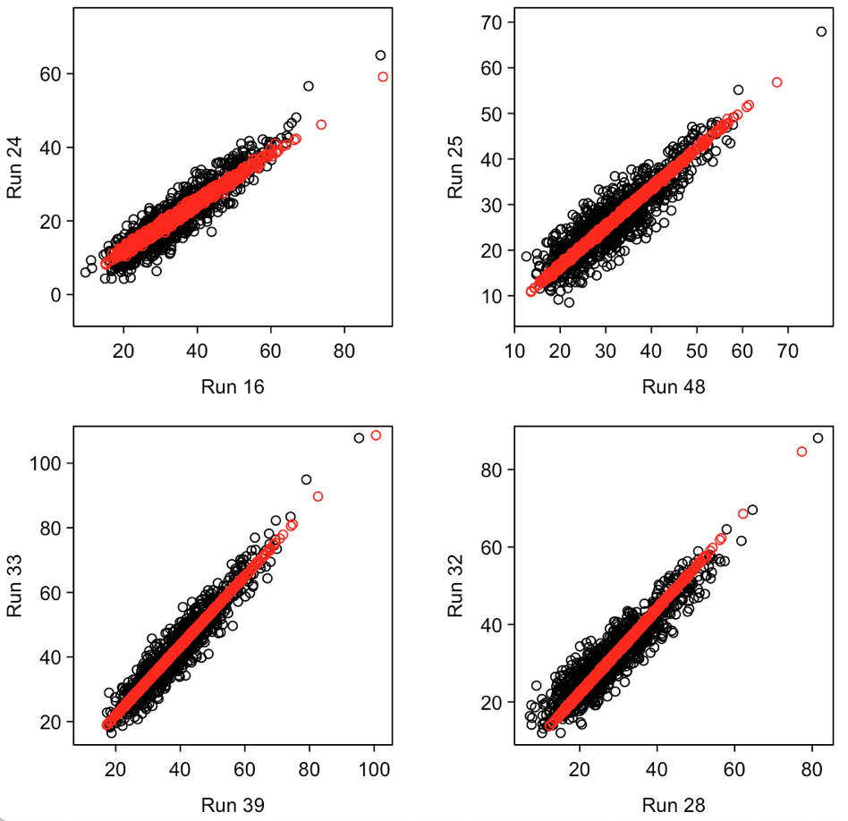
Total Least Squares by SVD/PCA
What about...
Non-linearity?
Missing data?
Unequal variances?
Experiments and peptides

Slide 43
Global Alignment Model

Slide 44
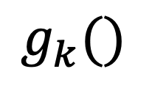
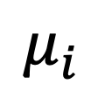
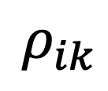
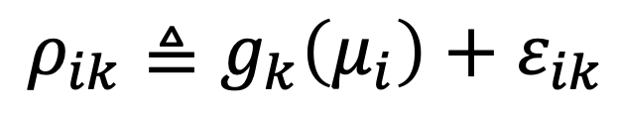
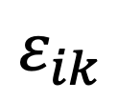
Global Alignment Model
$$ρ_{ik}≜g_{k}\left(μ_{i}\right)+ε_{ik}$$
$$ρ_{ik}$$
Observed RT, peptide i in experiment k
$$μ_{i}$$
Latent reference RT for peptide i
$$g_{k}()$$
Experimental transform
$$ε_{ik}$$
Error (unmodeled)
Notes:
Came up with a model where the reference RT is a latent variable (a variable whose value we don't know to begin with). With that latent variable we can make a model to the observed RTs and fit this model with ONE global fit to infer the latent reference RTs.

Slide 45
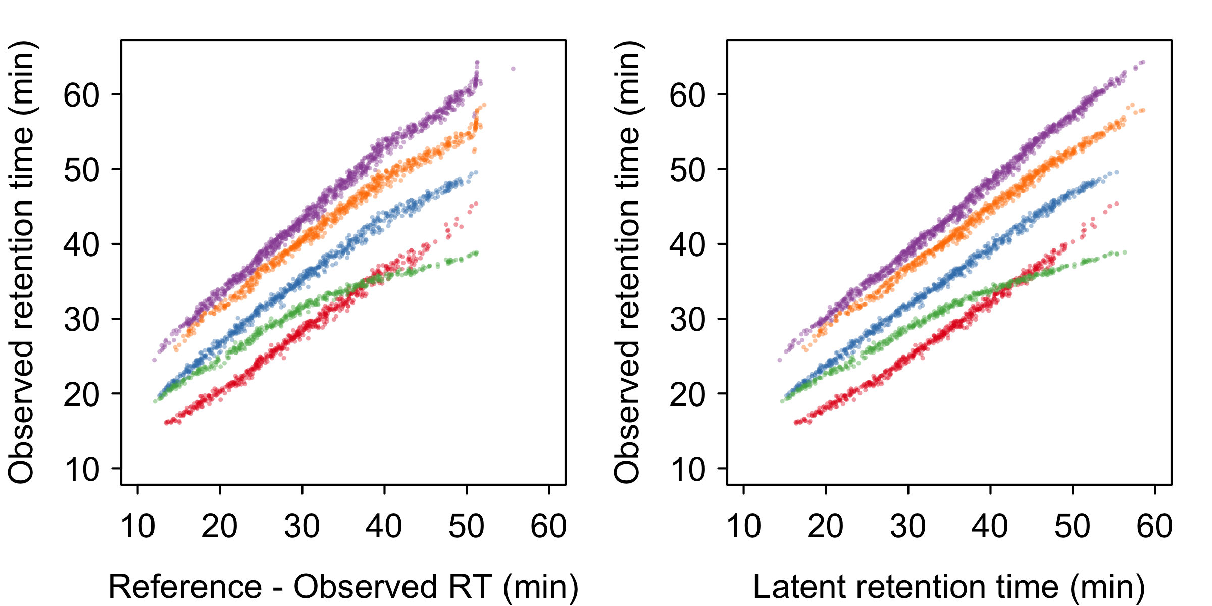
Global Alignment Model
Notes:
Instead of aligning multiple runs, shown here in 5 different colors, to one reference run...
We chose to model our retention times as latent variables in a “latent reference run”. This allows us to reconstruct the true retention time of peptides based on observations in a statistical model.

Slide 46
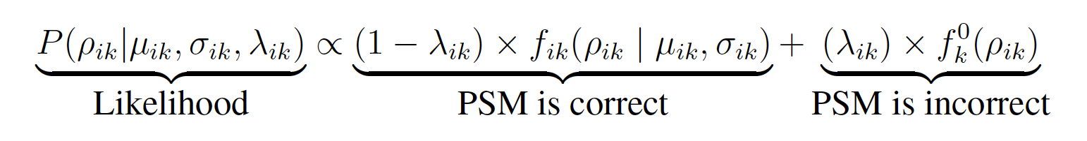
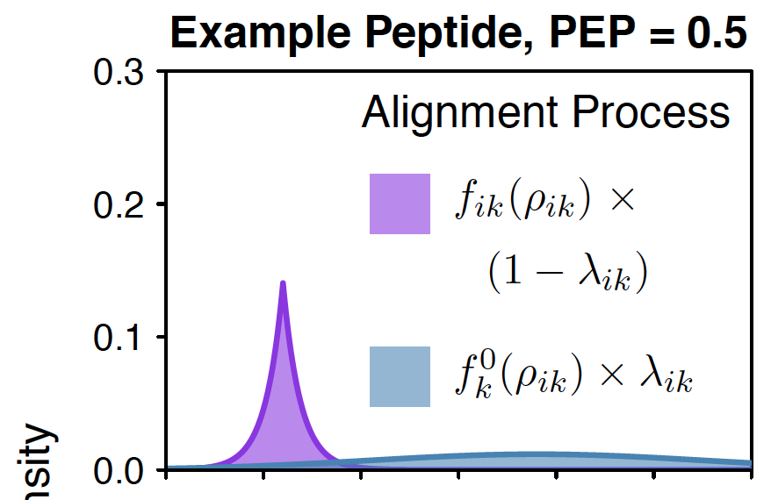
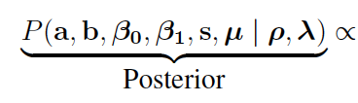
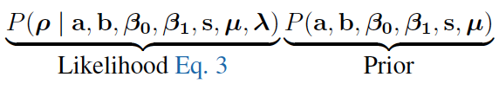
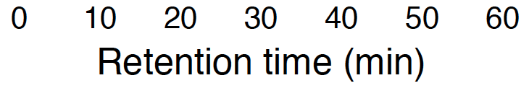
Global Alignment Model
Density

Slide 47


Slide 48



Notes:
One benefit of the model-based approach is that we get a lot of flexibility. For example, we can go from a simple linear fit to a two-segment fit, which we show can explain more variance. We can go even further with this and go to LOESS, multiple-spline fitting, etc.
We can also model heteroskedaticity (changes in variance), both between peptides and between experiments. In DART-ID we modeled variance as increasing with retention time, and we modeled experiment-specific variances independently to account for experiment-specific nuisances.

Slide 49

~50% More IDs at 1% FDR
Notes:
First off, we are able to get about 50% more PSMs at 1% FDR – these are identifications that would have been tossed in the garbage prior to using DART-ID.
We also show that these new IDs do not affect the overall error rate of our data – that is, we upgrade observations to the same degree that we downgrade others.

Slide 50


Slide 51

Notes:
With these new peptide IDs we are also able to fill in our missing data matrix more. While we can’t achieve the completeness that feature-matching algorithms can with MS1-level quantitation, this is a significant boost in the amount of data we have on hand. For analyses like PCA we can now include more proteins and we don’t have to impute as much data.

Slide 52


Slide 53

How are they different?
Notes:
In the beginning of this talk I floated some of the reasons why a spectra may receive a low-confidence hit, and here I’m showing the qualitative characteristics of the spectra that we do boost, from garbage to good.
They are on average noisier, with lower intensity and lower purity (as in they might contain bits of other peptides that muddy up the spectral matching). On the right we can also see that more of the TMT reporter ions are missing -- another indication that these spectra are noisier.
They also contain more missed cleavages, which is indicative of confidence downgrades due to an increased search space/multiple hypothesis testing
However, none of these differences are crippling. These distributions are largely overlapping and the differences in averages small – meaning that our boosted observations can be of just as high quality as our high-quality spectra when it comes to quantifying proteomes.

Slide 54


Slide 55


Slide 56


